Slide 1
SECURITY METRICS AND TRUSTED SYSTEMS

Slide 2
Measurements and metrics
Measure: A pure number
Metric: A ratio of two or more related measures.
Measurement is defined as the process of assigning symbols, usually numbers, to represent an attribute of the entity, by rule.
Metrics are the means of interpretation for the collected data.
A metric is defined as a standard of measurement using quantitative, statistical or mathematical analysis.

Slide 3
Measurements and metrics
A "measure" is a number that is derived from taking a measurement. Your height, weight or temperature would all be measures.
the number of visits to a website or the number of sales generated by campaign on Google's AdWords search network.
In contrast, a "metric" is a calculation between two measures. Typically, the calculation is a form of division.

Slide 4
Security metrics
Measuring security is an important discipline in order to understand whether your security posture is improving or degrading and to understand if your security programs are having the desired effect.
Infosec metric is the application of quantitative, statistical or mathematical analysis to measure infosec functional trends and workload.
Metrics enable continuous improvement.

Slide 5
Security metrics classification
Security metrics model consists of 3 components:
The object being measured
The security objectives
The method of measurement

Slide 6
Security objectives
Security objectives are divided into:
Security requirements such as specifications, standards and control objectives and common criteria
Best practices
Security baselines
Security management based on experience
Maturity models such as SSE-CMM and Infosec assurance capability maturity model (IA-CMM).

Slide 7
Methods of measurement
Methods of measurement include the following:
Direct testing
Evaluation
Assessment
Training/education/level of competence
Observation of system performance

Slide 8
Types of security metrics
Different types of security metrics that organizations can focus on can be:
Business impact
Business value gained/lost
Acceptable loss estimate
Program Results
Timeliness of security service delivery
Operational results
Process implementation
Level of implementation
Implementation totality

Slide 9
Why security metrics are important
Identifying key risks within the organization
Targeting remediation/mitigation action
Measuring internal compliance with organizational policy
Discovering internal process breakdown
Taking advantage of security related sunk costs

Slide 10
Security models
Bell-LaPadula model
Confidentiality
Biba model
Integrity
Clark Wilson model
Integrity

Slide 11
Terminology
Subjects
Subjects are active
Eg: Users/ Programs
Objects
Objects are passive
Eg: Files

Slide 12
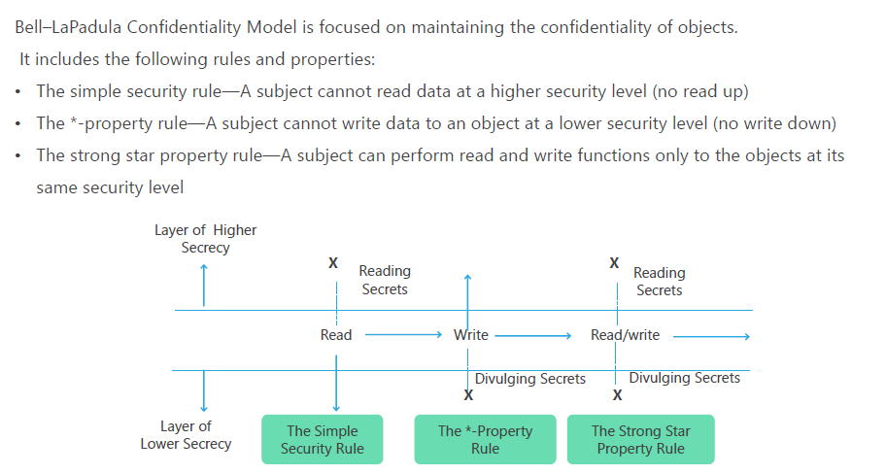
Bell-LaPadula Model

Slide 14
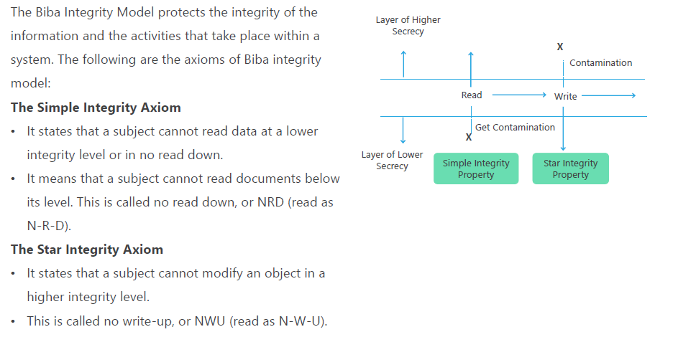
Biba model

Slide 16
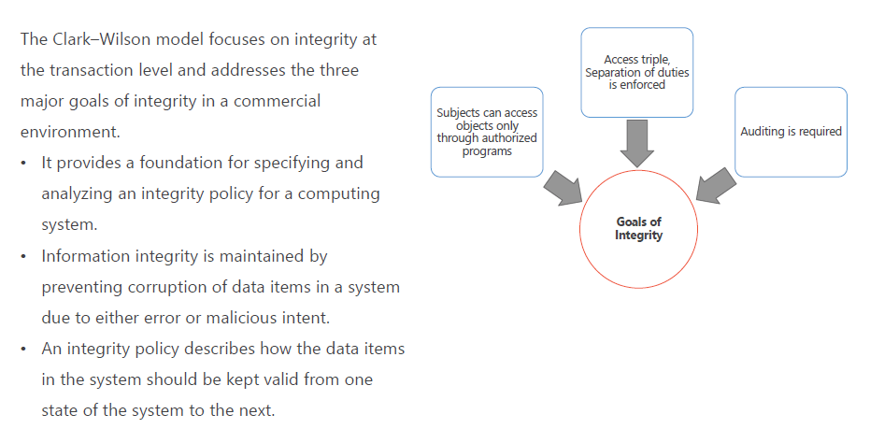
Clark Wilson Model

Slide 18
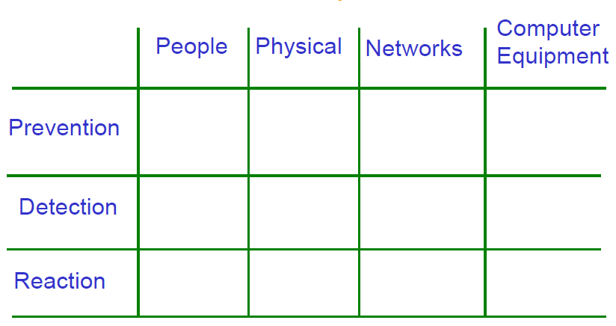
Security Matrix

Slide 19
The Security Matrix: uses
Use the matrix to focus measures where they are needed, and to be aware of what measures are being (purposely) neglected.
Drawing a threat/risk landscape. What areas are most at risk? Acceptable downtime.
Define future measures, baselines, or project specific security

Slide 20
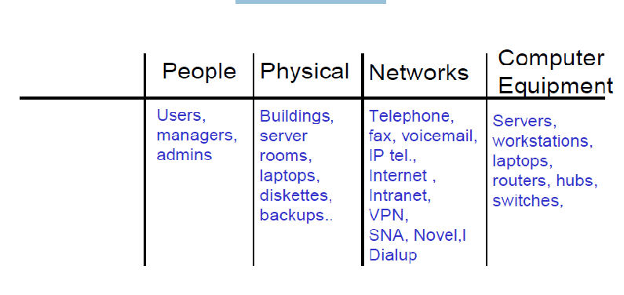
Examples

Slide 21
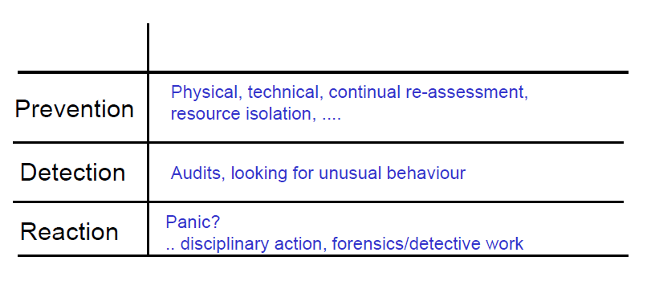
General measures

Slide 22
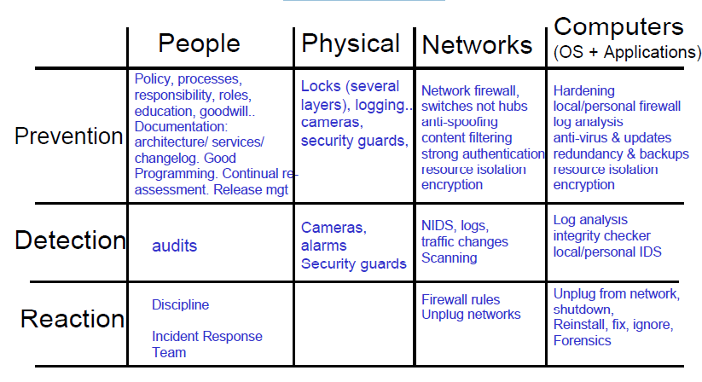
Measures

Slide 23
Computer Crime Security and Privacy
Data communications capabilities provides new challenges
Keep data secure
Destruction
Accidental damage
Theft
Keep data private
Salaries
Medical information
Social security numbers

Slide 24
Ways to secure data
Locked servers
Removable hard drives that are locked when not in use
Hard disk drives requiring special tools for detachment
Physical cages around computers that prohibit access

Slide 25
Security
System of safeguards designed to protect a computer system and data from deliberate or accidental damage
Natural disasters
Fire
Accidents
Theft
Theft or destruction of data
Industrial espionage

Slide 26
Security Identification and Access
Provide access to authorized individuals only
Uses one of more of the following systems
What you have
What you know
What you do

Slide 27
Security Identification and Access
What You Have
Key
Badge
Token
Plastic card – magnetized strip

Slide 28
Security Identification and Access
What You Know
Password
Identification number

Slide 29
Security Identification and Access
What You Do

Slide 30
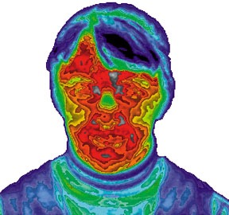
Security Identification and Access
What You Are
Biometrics – science of measuring individual body characteristics
Fingerprints
Voice pattern
Retina of the eye

Slide 31
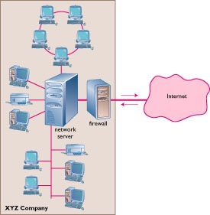
Security The Internet
Firewall
Dedicated computer that governs interaction between internal network and the Internet
Encryption
Data Encryption Standard (DES)

Slide 32
Security Personal Computers
Physical security with locks and cables
Surge protector
Uninterruptible power supply (UPS)

Slide 33
Privacy
Where is my data?
How is it used?
Who sees it?

Slide 34
Privacy How Did They Get My Data?
Loans
Charge accounts
Orders via mail
Magazine subscriptions
Tax forms
Applications for schools, jobs, clubs
Insurance claim
Hospital stay
Sending checks
Fund-raisers
Advertisers
Warranties
Military draft registration

Slide 35
Privacy Your Boss is Spying on You!
Monitoring software
Screens
E-mail
Keystrokes per minute
Length of breaks
What computer files are used and for how

Slide 36
Privacy Monitoring by Web Sites
Records:
City
Site you just left
Everything you do while on the site
Hardware and software you use
Click stream
Series of clicks that link from site to site

Slide 37
Privacy Monitoring by Web Sites
Cookie
Stores information about you
Located on your hard drive
Beneficial uses
Viewing preferences
Online shopping
Secure sites retain password in cookie
Controversial use
Tracking surfing habits for advertisers
Can set browser to refuse cookies or warn before storing

